Slide 1


Slide 2


Slide 3


Slide 4
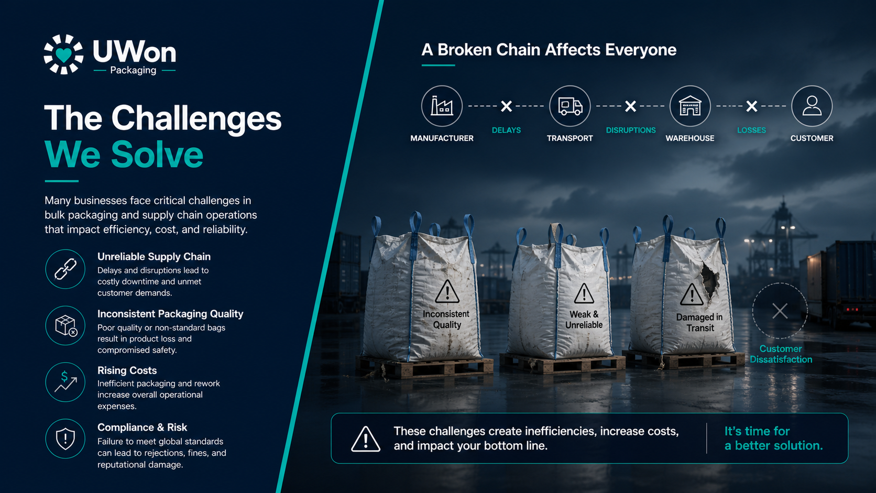

Slide 5
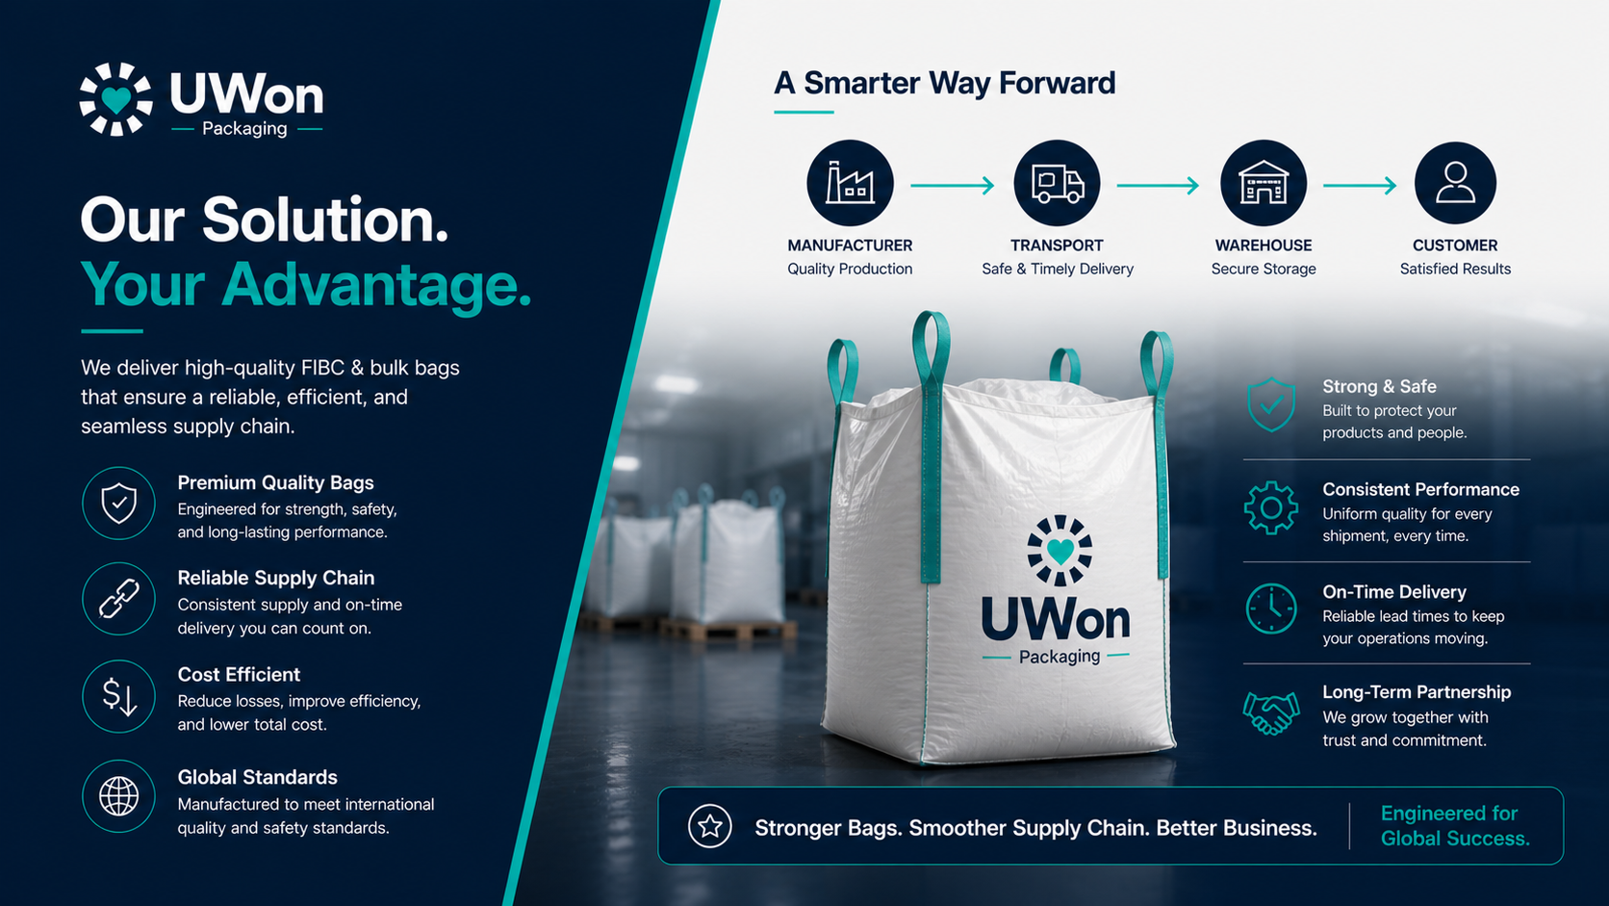

Slide 6
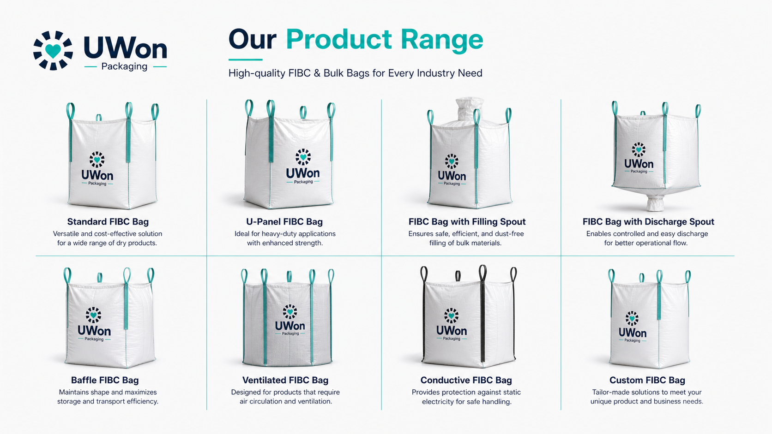

Slide 7
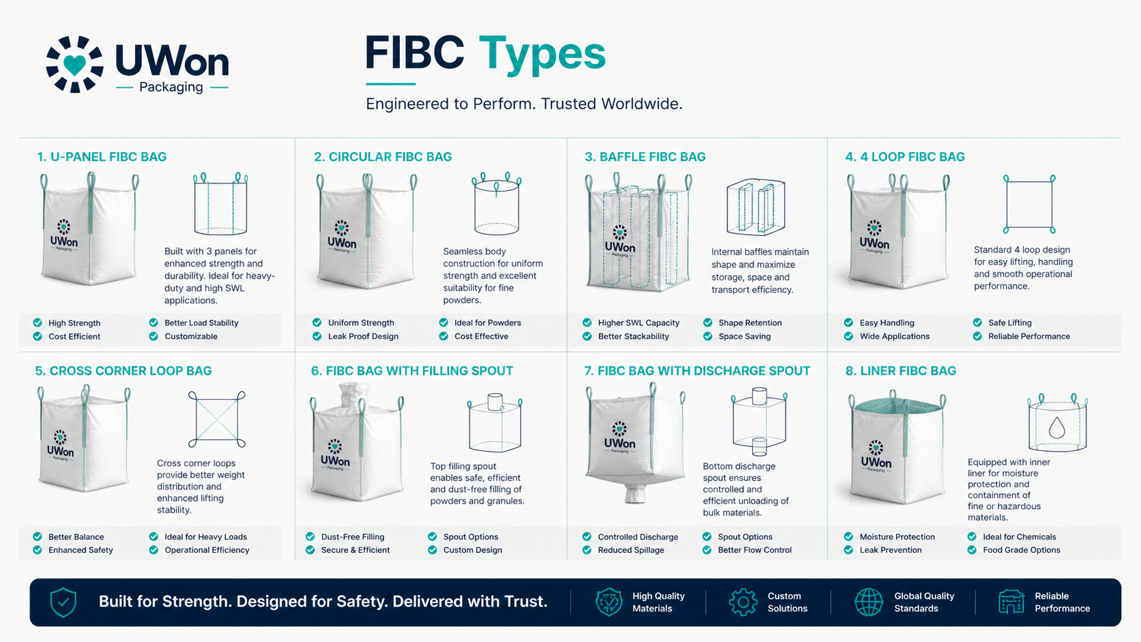

Slide 8
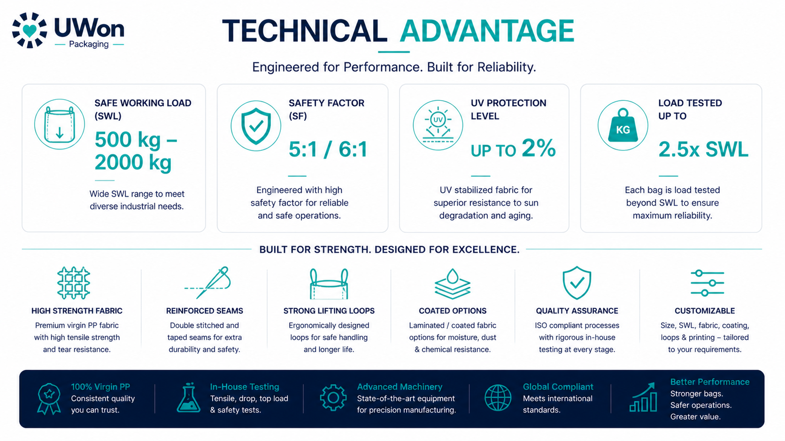

Slide 9


Slide 10


Slide 11
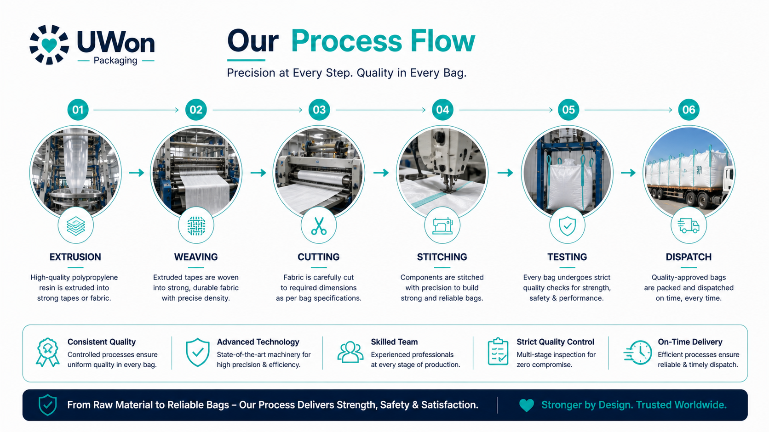

Slide 12
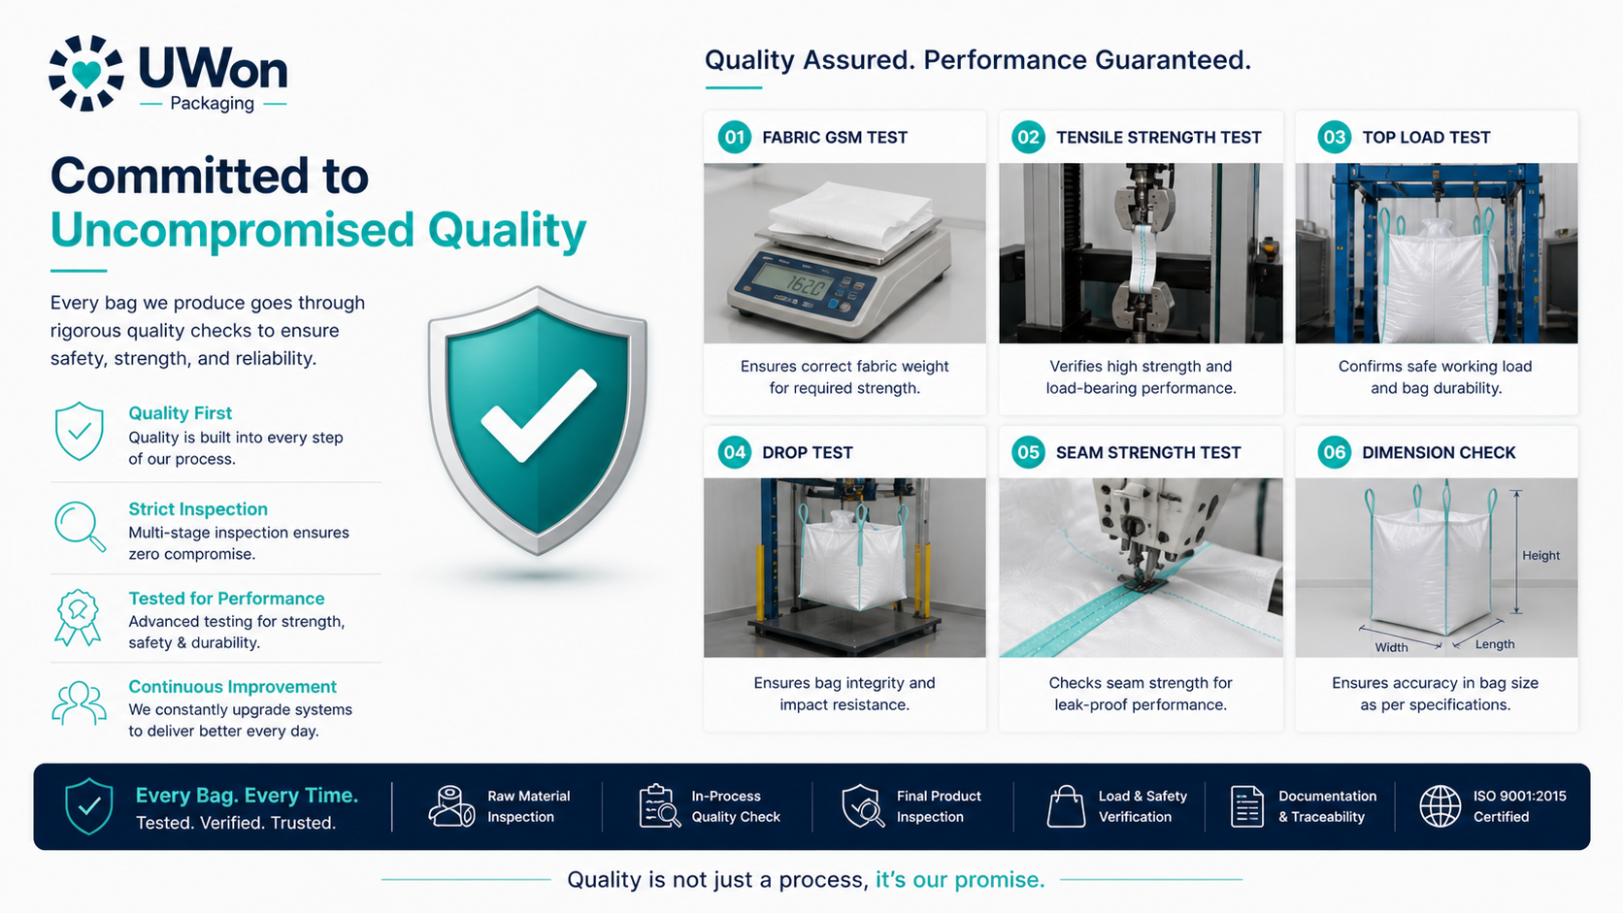

Slide 13


Slide 14
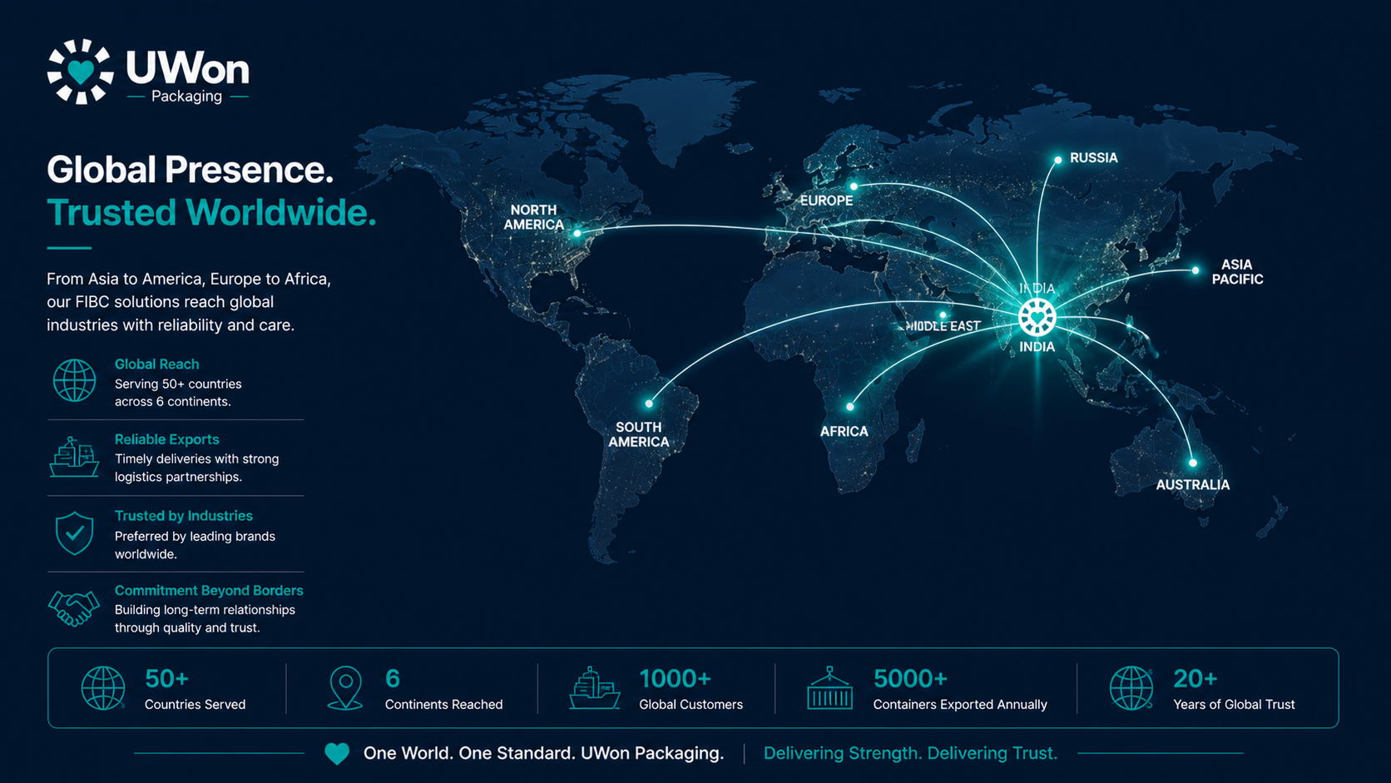

Slide 15


Slide 16
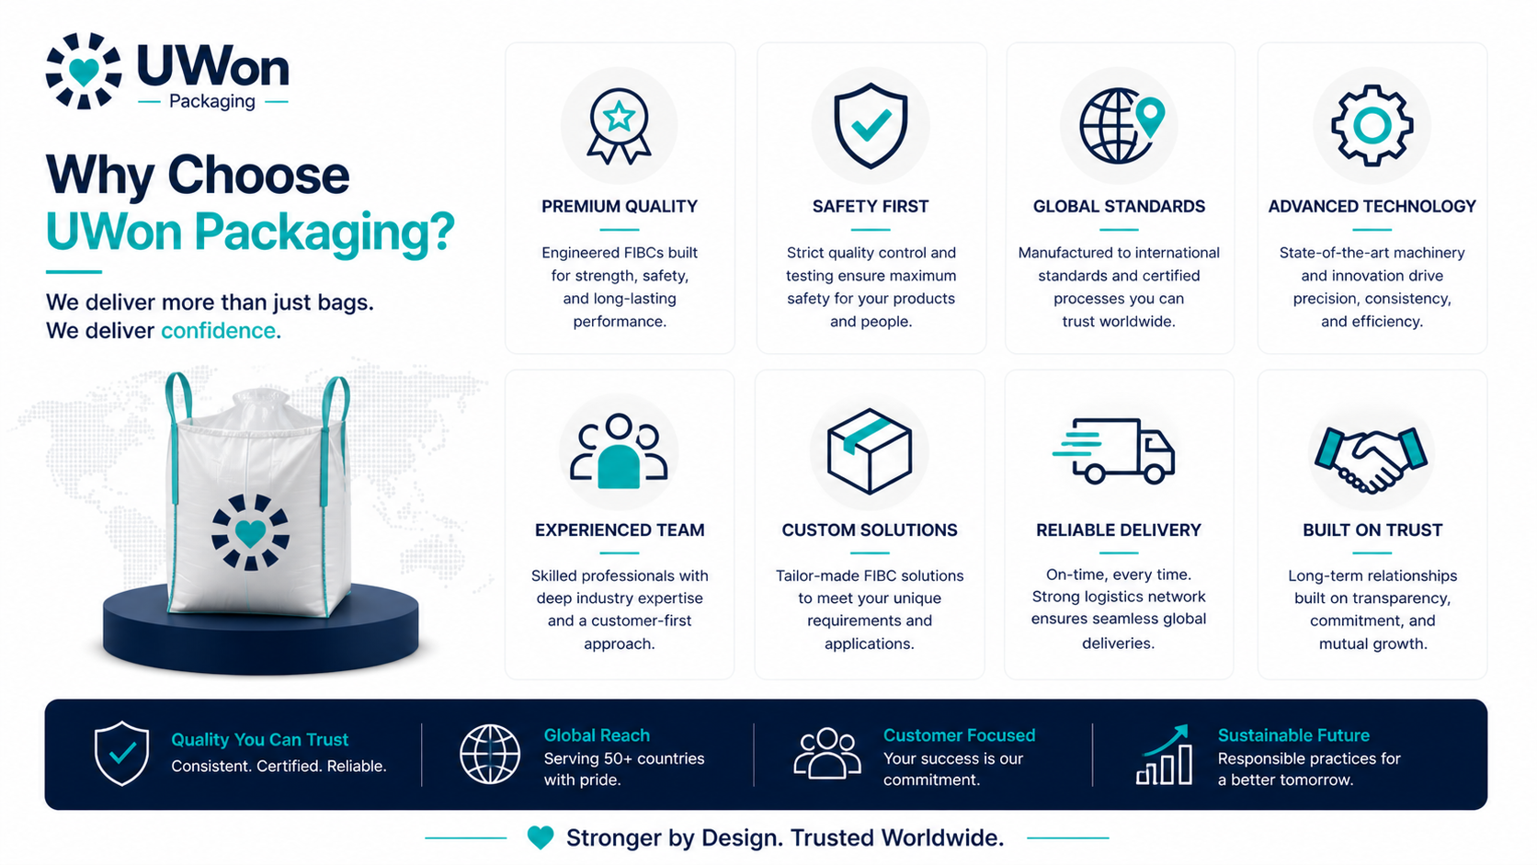

Slide 17


Slide 18


Slide 19
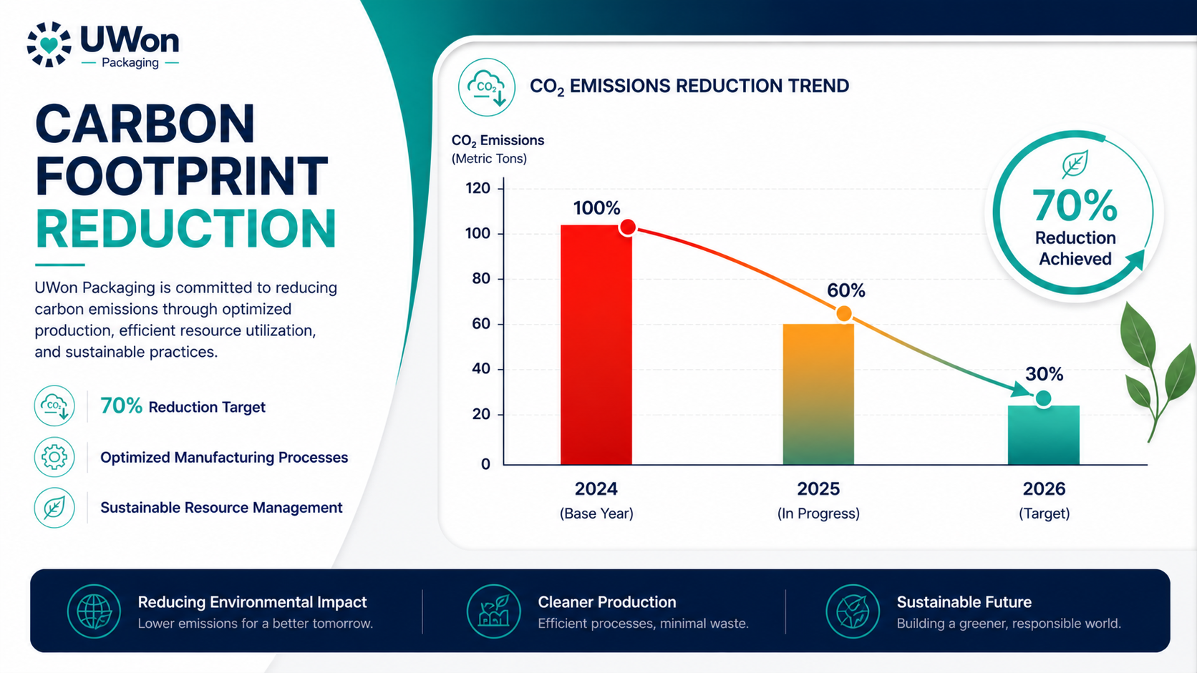

Slide 20
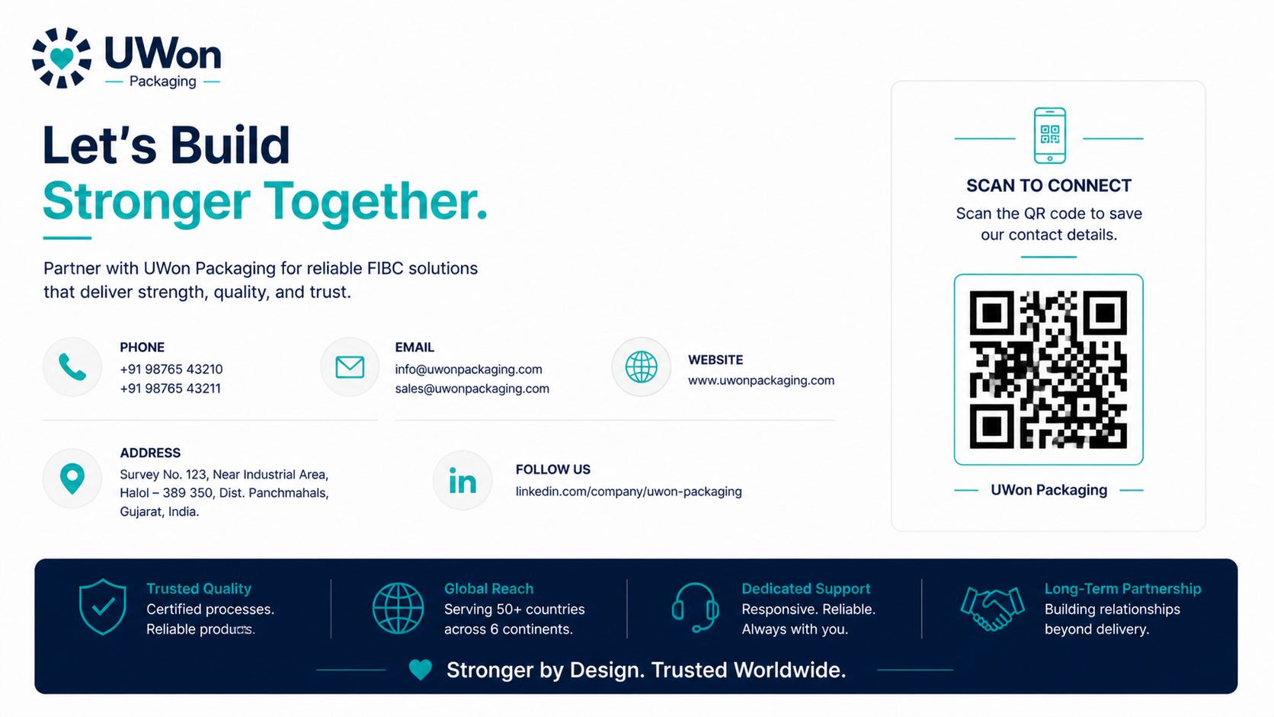
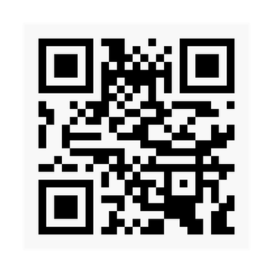







+91 89629 51000/31000
marketing@uwonpackaging.com
www.uwonpackaging.com
1646/1645, Masatiyo Ki Madri, Tehsil - Kunwariya, Rajsamand Rajasthan, India - 313324
in
f

Slide 21


